Slide 1

Implementing Web Governance on Your Campus
mark a. greenfield

Slide 2

Mark Greenfield
Higher ed web professional, consultant, keynote speaker, futurist, uwebd overlord, lacrosse coach, tennis player, music lover, dog rescuer
markgr.com
twitter.com/markgr
delicious.com/markgr
www.linkedin.com/in/markgr
Notes:
2

Slide 3
Agenda
Introduction
Governance
Strategy
Operations
Evaluation
Concluding Thoughts
Notes:
3

Slide 4

Getting Started
How do problems associated with
web governance manifest themselves?

Slide 5
Introducing Web Governance
Notes:
5

Slide 6
the .edu lifecycle
web governance
Operations
Evaluation
Strategy
web governance
web governance
web governance

Slide 7
True or False
Most college web sites are bad?
Notes:
7

Slide 8
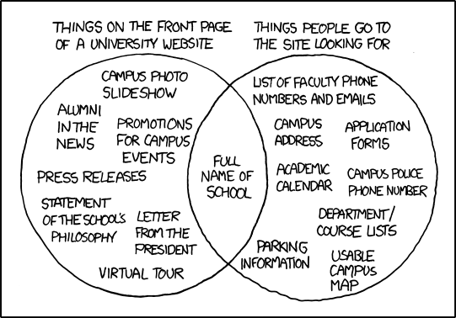
University Website
xkcd.com
Notes:
8

Slide 9
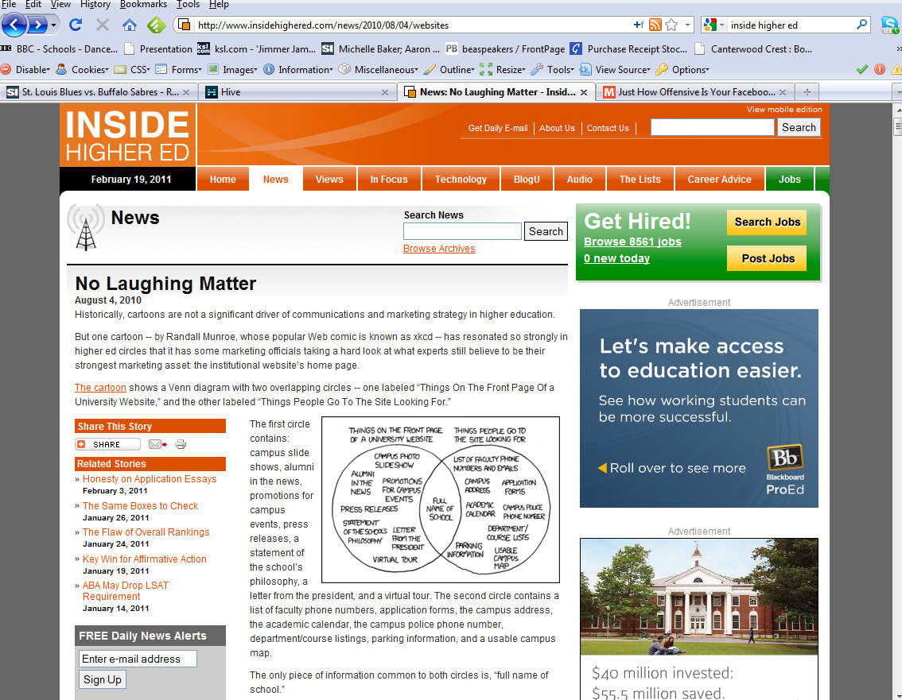
Notes:
9

Slide 10
It’s Not Our Fault
(most of the time)
Notes:
10

Slide 11
Most colleges address web quality by redesigning their site or investing in infrastructure when the real problem lies in the management practices.
Notes:
11

Slide 12
Implementing a CMS without web governance is like building a bridge to nowhere
Notes:
12

Slide 13

Without
Web Governance
Notes:
13

Slide 14
The web is thought of as a collection of micro-sites rather than a single entity. Academic departments and administrative units think they have their own sites rather than being part of a larger web ecosystem.
Notes:
14

Slide 15
The Entire Site Matters!
Notes:
15

Slide 16
Usability suffers because visitors expect a unified web presence and instead find a site that is graphically diverse and difficult to navigate.
Notes:
16

Slide 17
There are no articulated, measurable goals making it difficult to measure the ROI of web efforts.
Notes:
17

Slide 18
With everyone doing their own thing, there are resource inefficiencies that result in wasting time and money.
Notes:
18

Slide 19
Not enforcing policies and not following standards exposes the institution to risk.
Notes:
19

Slide 20
Campus leadership views the web as a cost center rather than as a strategic asset
Notes:
20

Slide 21
The challenge of implementing web governance in higher education
Notes:
21

Slide 22

Notes:
22

Slide 23

Notes:
23

Slide 24


Slide 25
colleges and universities as “organized anarchies”
Notes:
25

Slide 26


Slide 27
Notes:
27

Slide 28

Notes:
28

Slide 29
the two things that get the attention
of senior management
Notes:
29

Slide 30

Notes:
30

Slide 31

Notes:
31

Slide 32
Discussion
What are the risks associated with a bad web site and poor process?
Notes:
32

Slide 33
The Tipping Point
The web is now mission critical
Growing expectations of millennial students
Higher education is getting flattened
Notes:
33

Slide 34
Flattened
When the impact of the internet and globalization render and industry unrecognizable, and in many cases, obsolete

Slide 35
44%
believe that waste and mismanagement significantly factor into increasing college costs
Notes:
35

Slide 36
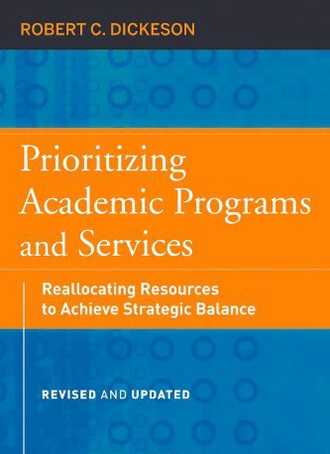
“Most institutions can no longer afford to be what they’ve become”
Notes:
36

Slide 37
higher education will need to become
ruthlessly efficient
Notes:
37

Slide 38
the .edu lifecycle
web governance
Operations
Evaluation
Strategy
web governance
web governance
web governance

Slide 39

Web Governance
an organization's structure of staff (each with well-defined roles, responsibilities, and authorities); technical systems; and the policies, procedures, and relationships such staff have in place to maintain and manage a website.
Notes:
39

Slide 40
Web Governance
Deciding who gets to decide
(assigning roles and responsibilities, then holding those people accountable)
Notes:
40

Slide 41

HiPPO
HIghest Paid Person’s Opinion
Notes:
41

Slide 42
Decisions must be based on expertise, not power
Notes:
42

Slide 43
Discussion
Do you have web governance on your campus?
How well is it working?
Notes:
43

Slide 44
Your web governance model must map to existing campus governance models
Notes:
44

Slide 45


Notes:
45

Slide 46
role conflict and role ambiguity are
the sources of many problems in institutions of higher education
Notes:
46

Slide 47
Institutional Dynamics
Size and Scope (carnegie classifications)
Decision Making (democratic, consensus, garbage can)
Culture (collegial, adhocracy, hierarchy, market)
Organizational Structure (functional, product, matrix)
Governance (centralized, decentralized, federated)
Notes:
47

Slide 48
one size does not fit all
Notes:
48

Slide 49

Notes:
49

Slide 50
Web Governance Process
Perform a web governance audit
Perform a web governance self-assessment
Quantify the value of the web
Create a web governance charter
Notes:
50

Slide 51
Web Governance Charter
Introduction
  Nature of web governance
  Objectives
  Scope
  Guiding Principles
Governance
  Committee Structure
  Project prioritization process
  Appeals Process
  Resource allocation principles
  Authority (roles and responsibilities)
  Communication
Evaluation
Notes:
51

Slide 52
Notes:
52

Slide 53
Web Governance Model
Group | Focus | Membership | Outputs
Web Council | Strategic (what) | CIO, CMO, COO,CFO,CWO | Web charter, high-level strategy project prioritization, resources
Advisory Board | Tactical (how) | Web managers, Stakeholders | Policies, standards, project management
Web Forum | Operational (implementation) | All web staff, Subject matter experts | Content, communication, coordination, collaboration
Notes:
53

Slide 54

Notes:
54

Slide 55
campus committees = legal hostage situations
Notes:
55

Slide 56
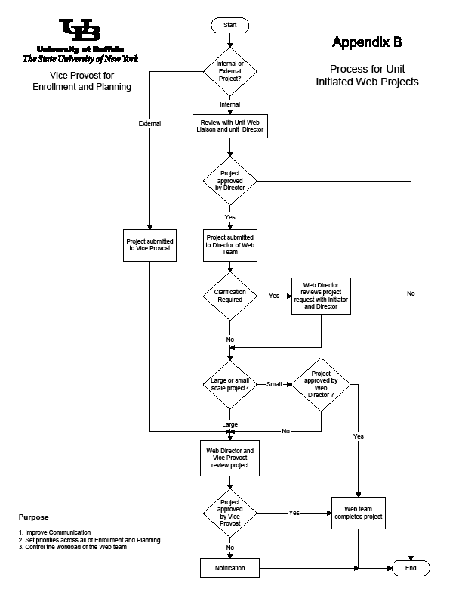
Notes:
Focusing on ROI has many benefits. First, it can be used as the basis for a formal evaluation process for prioritizing projects. Too often, ad hoc decisions are made without a formal structure and process, resulting in an inefficient use of resources.
Determining ROI prior to working on a project also sets expectations and helps determine if a project was successful. ROI also brings accountability into the equation by holding people responsible for the success or failure of a given project. Finally, web teams that use ROI are more valued and taken more seriously by management.

Slide 57
Web Governance Process
Perform a web governance audit
Perform a web governance self-assessment
Quantify the value of the web
Create a web governance charter
Develop policies and standards
Notes:
57

Slide 58
Web Policies
A set of legal, compliance related, editorial and technical constraints for web development
Focus is on mitigating risk
Will include both updates to existing policies and new policies explicit to the web
Notes:
58

Slide 59
Policies, by definition, are enforced.
There are consequences when policies
are not followed.

Slide 60
If there is no benefit in following a policy or consequence for violating it, it becomes nothing more than an institutional artifact.
Notes:
60

Slide 61
Web Standards
Should be created by a team of web experts with informed input from campus stakeholders
Should involve the entire campus
Real standards are enforced, but with the approach of enabler rather than naysayer
Standards often fail because they are bad standards
Notes:
61

Slide 62
Web Standards
Editorial
Design
Information Architecture
Web Tools and Applications
Network and Server Infrastructure
Notes:
62

Slide 63
Discussion
Do you have web policies and standards?
Are they enforced?
Notes:
63

Slide 64
the .edu lifecycle
web governance
Operations
Evaluation
Strategy
web governance
web governance
web governance

Slide 65
“There is nothing so useless as
doing efficiently that which
should not be done at all.”
- Peter Drucker
Notes:
65

Slide 66
Web Strategy
The use and allocation of organizational resources to accomplish long-term objectives
Notes:
66

Slide 67
Why do you have a website?
Notes:
67

Slide 68
know the problem you are trying to solve
Notes:
68

Slide 69
decisions need to be made based on strategy,
not historical precedent or politics
Notes:
69

Slide 70
Institutional
Strategy
Communications
Strategy
Web
Strategy
IT
Strategy
Content
Strategy
Social Media
Strategy
Notes:
70

Slide 71
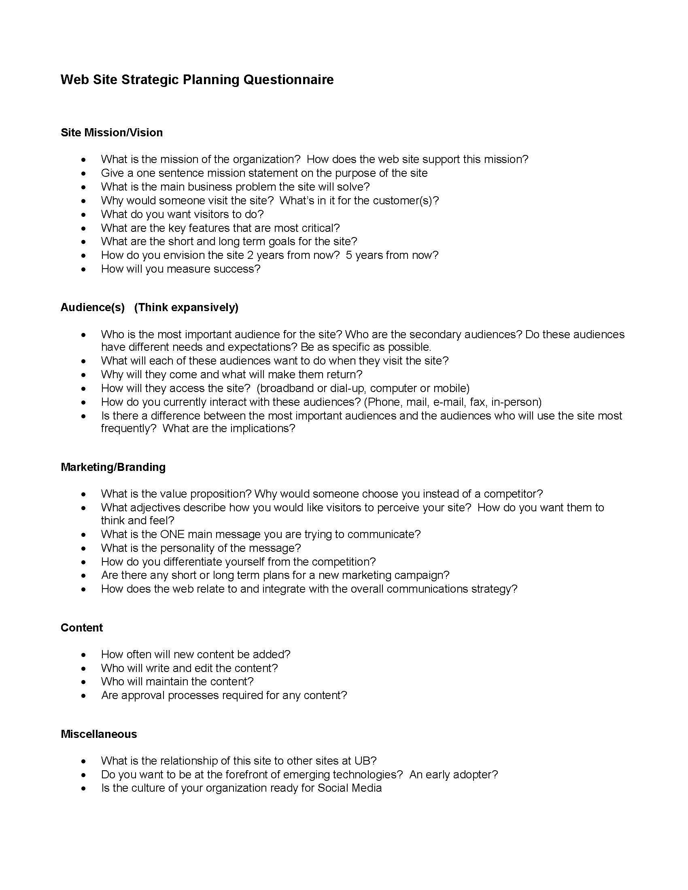
Notes:
71

Slide 72
the .edu lifecycle
web governance
Operations
Evaluation
Strategy
web governance
web governance
web governance

Slide 73
Web Operations
effective, efficient management
of daily web operations.
Notes:
73

Slide 74
Is your site sustainable?
Notes:
74

Slide 75
The Web Is Not a Project
Notes:
75

Slide 76

Notes:
76

Slide 77
Web Operations
How efficient are daily web operations?
Is information published on a timely manner?
Are all processes and procedures documented?
Is there good communication and interaction between everyone involved with the web?
Is there appropriate backup and redundancy?
Notes:
77

Slide 78
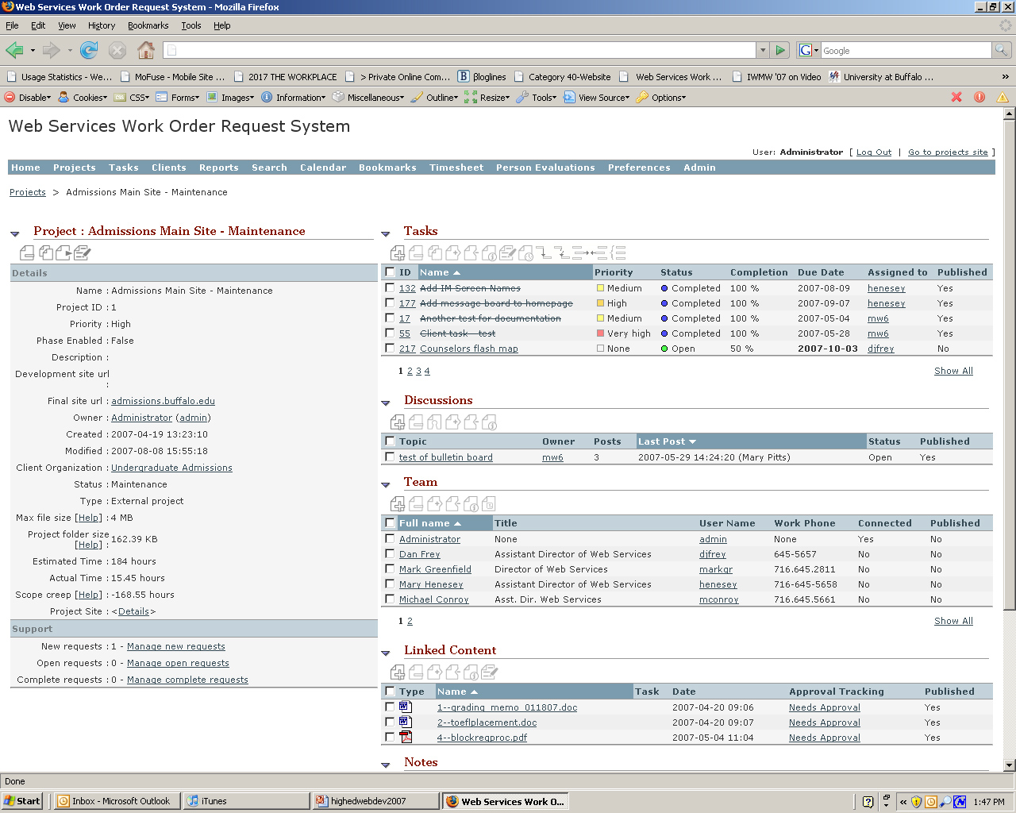
Notes:
Recently we have been using our project management/work order request system to track the exact time we spend on both new projects and the maintenance of existing sites and applications. This allows us to better understand the ROI of each site and application we create. I was always able to provide fairly accurate guesstimates, but because we are now providing real numbers on the resources allocated to each project, our efforts are taken more seriously by management.

Slide 79
Where should the web team report?
Notes:
79

Slide 80

IT or Marketing

Slide 81

let there be web divisions

Slide 82

Notes:
82

Slide 83
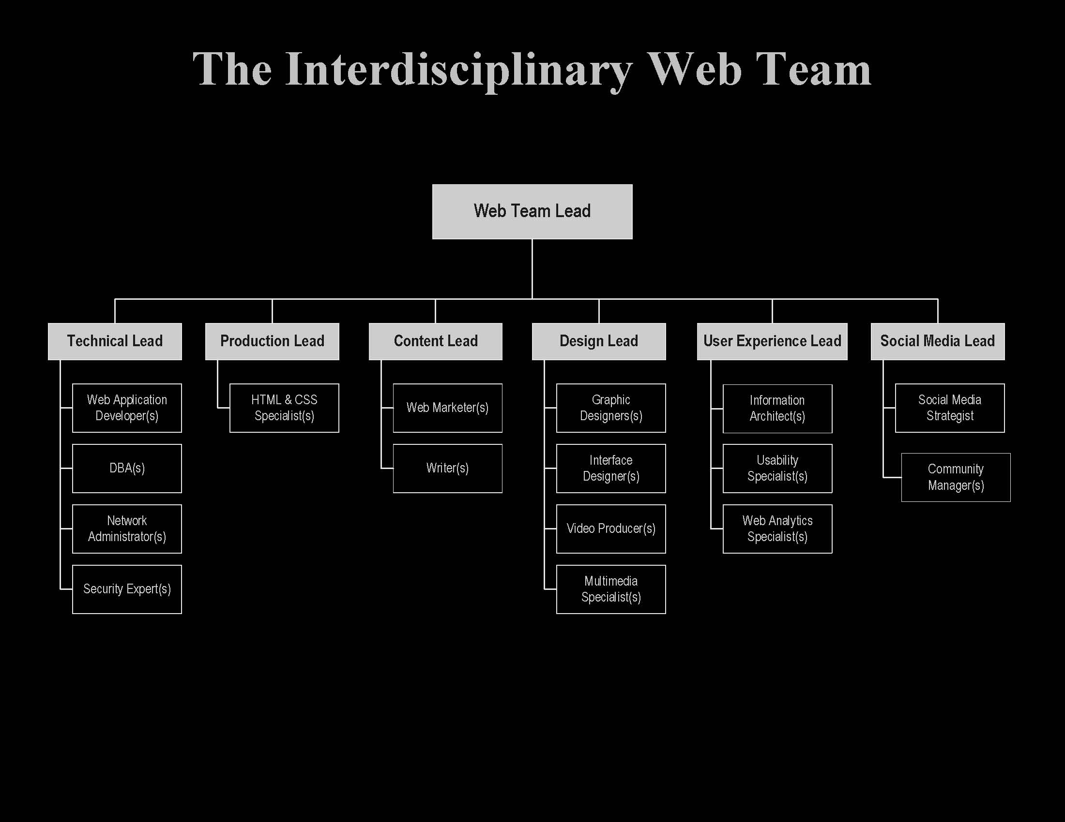

Slide 84
Is higher education ready for the idea of a CWO (Chief Web Officer)?
Notes:
84

Slide 85
the .edu lifecycle
web governance
Operations
Evaluation
Strategy
web governance
web governance
web governance

Slide 86
Web Evaluation
Must measure both the product and the process
Must measure both web and business metrics
All data must be actionable
Must use a combination of qualitative and quantitative methodologies
Include increased efficiencies and cost savings
Include real costs of web efforts
Notes:
86

Slide 87
What would happen if your web site
disappeared tomorrow?
Notes:
87

Slide 88
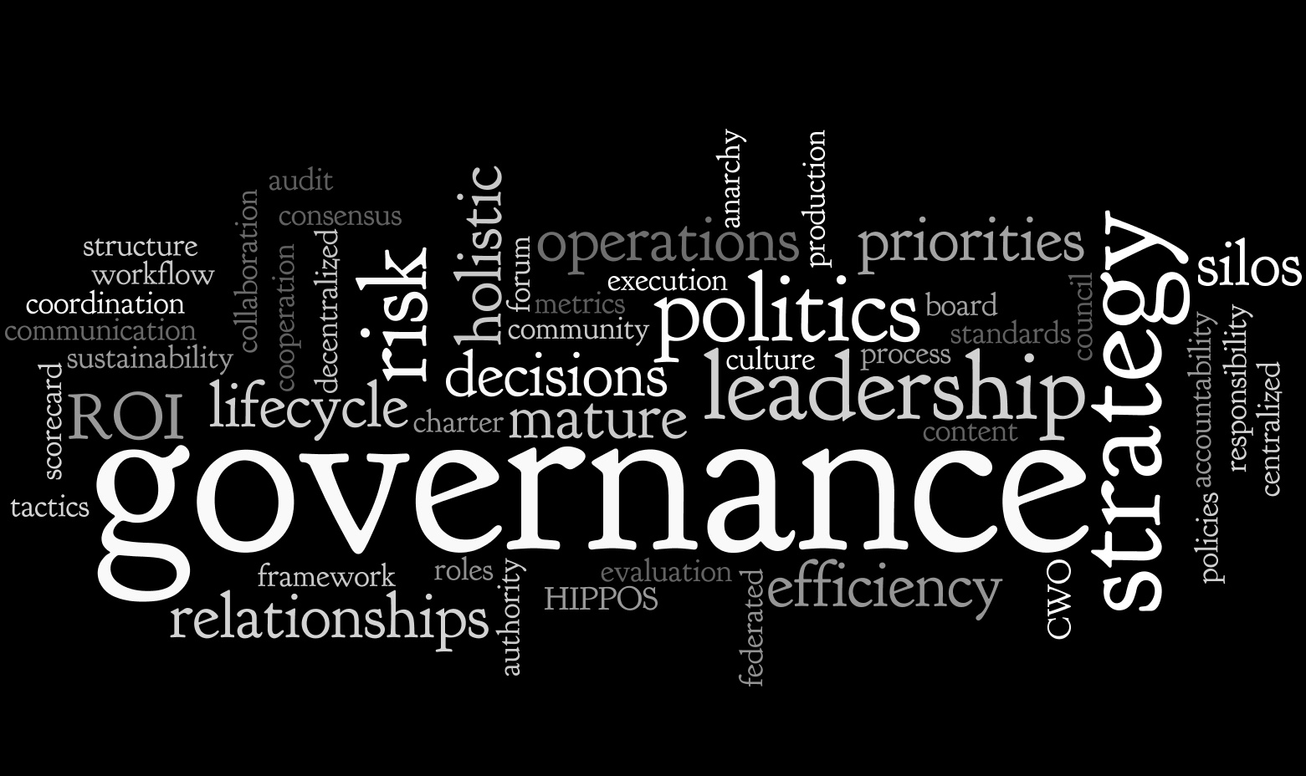
Concluding Thoughts
Notes:
88

Slide 89
True Web Governance
Establishes authority and accountability
Notes:
89

Slide 90
True Web Governance
Establishes authority and accountability
Defines the role of all campus units as it relates to the web and establishes how they will support web efforts
Notes:
90

Slide 91
True Web Governance
Establishes authority and accountability
Defines the role of all campus units as it relates to the web and establishes how they will support web efforts
Involves senior leadership
Notes:
91

Slide 92
True Web Governance
Establishes authority and accountability
Defines the role of all campus units as it relates to the web and establishes how they will support web efforts
Involves senior leadership
Involves line management
Notes:
92

Slide 93
True Web Governance
Establishes authority and accountability
Defines the role of all campus units as it relates to the web and establishes how they will support web efforts
Involves senior leadership
Involves line management
Is not a one-off process
Notes:
93

Slide 94
Web Governance Artifacts
Governance Charter
Web Policy
Web Strategy
Web Standards
Resource Allocation
Project Prioritization
Web Metrics
Notes:
94

Slide 95
web governance
is your friend
Notes:
95

Slide 96
good web governance will
eliminate campus politics
Notes:
96

Slide 97
Find the delicate balance between
autonomy and accountability.
Notes:
97

Slide 98
The Key to Success
Notes:
98

Slide 99

Leadership
Notes:
99

Slide 100
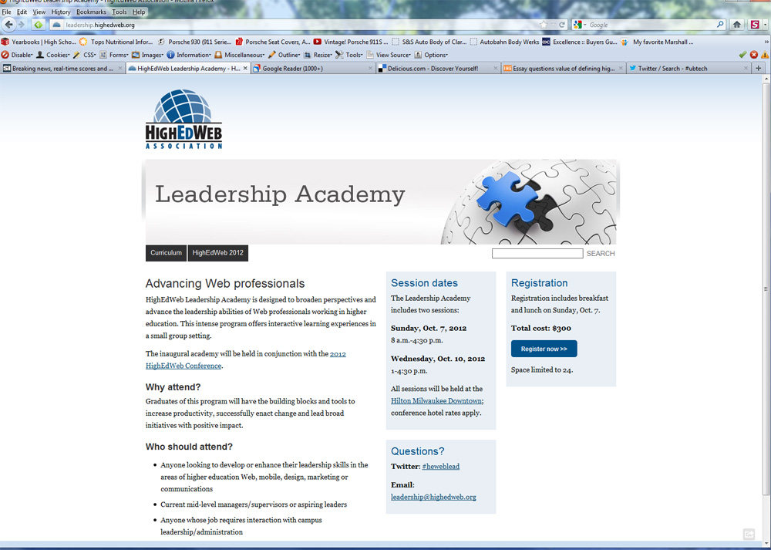
Notes:
100

Slide 101


Slide 102
there is no such thing as a web project

Slide 103
Keys to Successful Web Governance
Understand your campus dynamics
Executive sponsor
Become ruthlessly efficient
Become a web evangelist
Continuous evaluation of both the product (website) and the process
Notes:
103

Slide 104
Community
Communication
Collaboration
Cooperation
Coordination

Slide 105
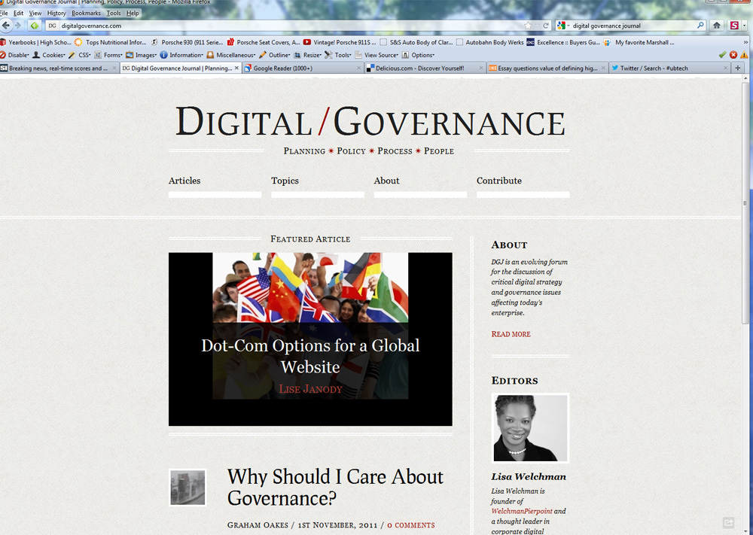
Notes:
105

Slide 106
Thank You
mark a greenfield
markgr.com
twitter.com/markgr
delicious.com/markgr
www.linkedin.com/in/markgr

