Slide 1

Managing the Convergence of Web Content, Social Media and Mobile Devices
mark a greenfield

Slide 2

Mark Greenfield
Higher ed web professional, consultant, keynote speaker, futurist, uwebd overlord, lacrosse coach, tennis player, music lover, dog rescuer
markgr.com
twitter.com/markgr
delicious.com/markgr
www.linkedin.com/in/markgr
Notes:
2

Slide 3
markgr.com/maweb2012
Notes:
3

Slide 4
Two Goals
Think about how you think about content.
Think about how you think about the web and technology.
Notes:
4

Slide 5
Content
What it is (rich media and more)
Notes:
5

Slide 6
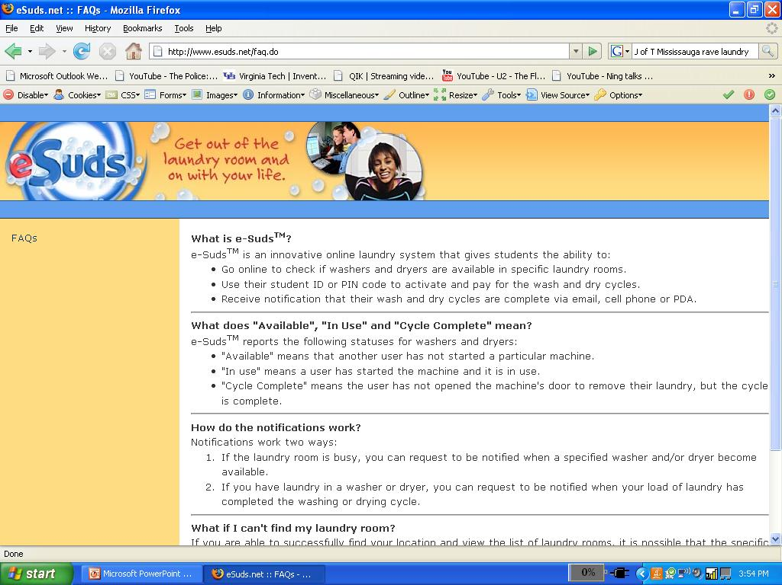

Slide 7
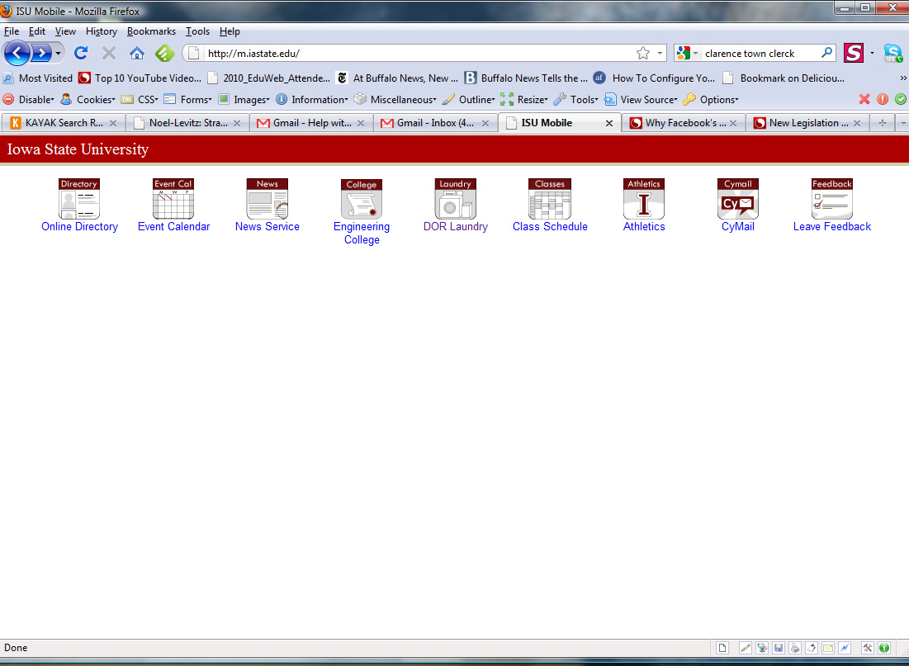

Slide 8
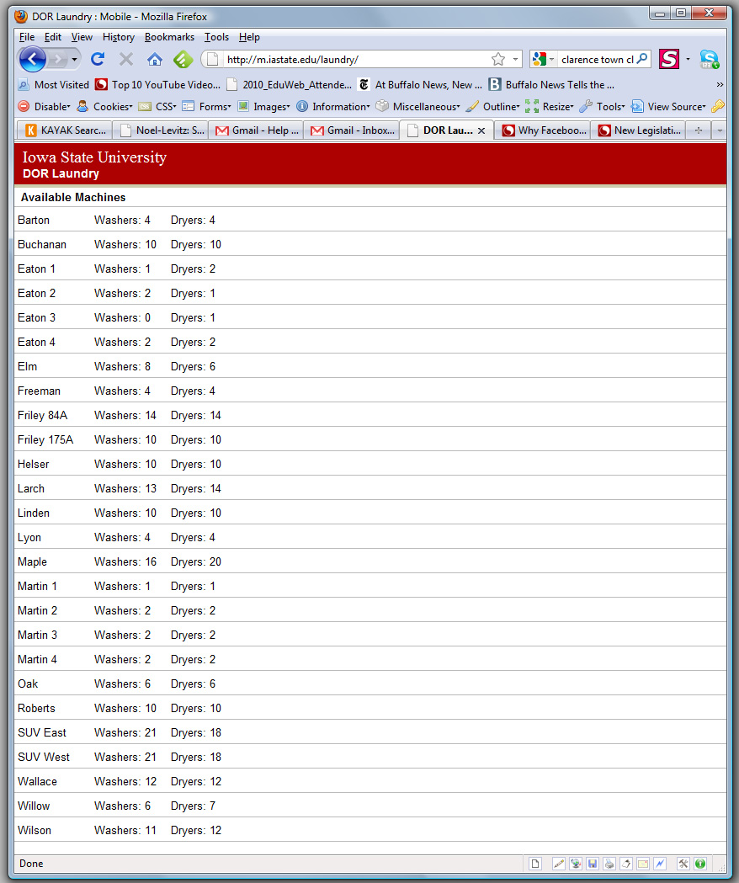

Slide 9
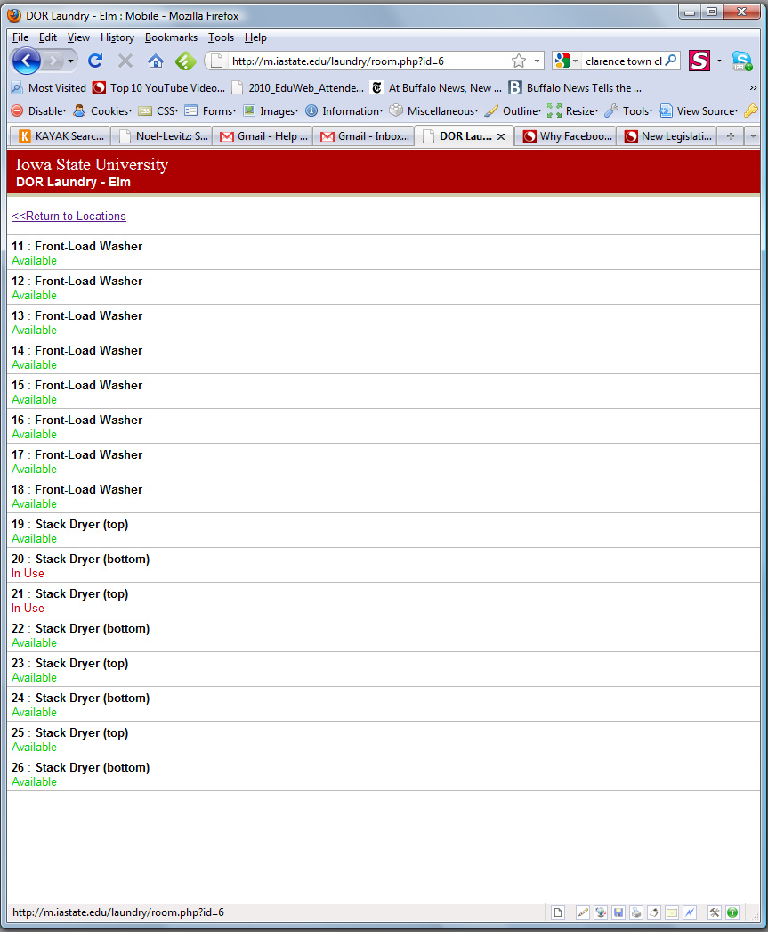

Slide 10
Content
What it is (rich media and more)
Who creates it (social media)
Notes:
10

Slide 11

Defining Social Media
Notes:
11

Slide 12
spaces on the internet where people came to exchange content
Notes:
12

Slide 13

Dialogue, not Monologue
Notes:
13

Slide 14
Content
What it is (rich media and more)
Who creates it (social media)
How it’s structured
Notes:
14

Slide 15
Content
What it is (rich media and more)
Who creates it (social media)
How it’s structured
How it’s consumed
Notes:
15

Slide 16
Content
What it is (rich media and more)
Who creates it (social media)
How it’s structured
How it’s consumed
How fast it’s made available
Notes:
16

Slide 17

the real-time web

Slide 18


Slide 19
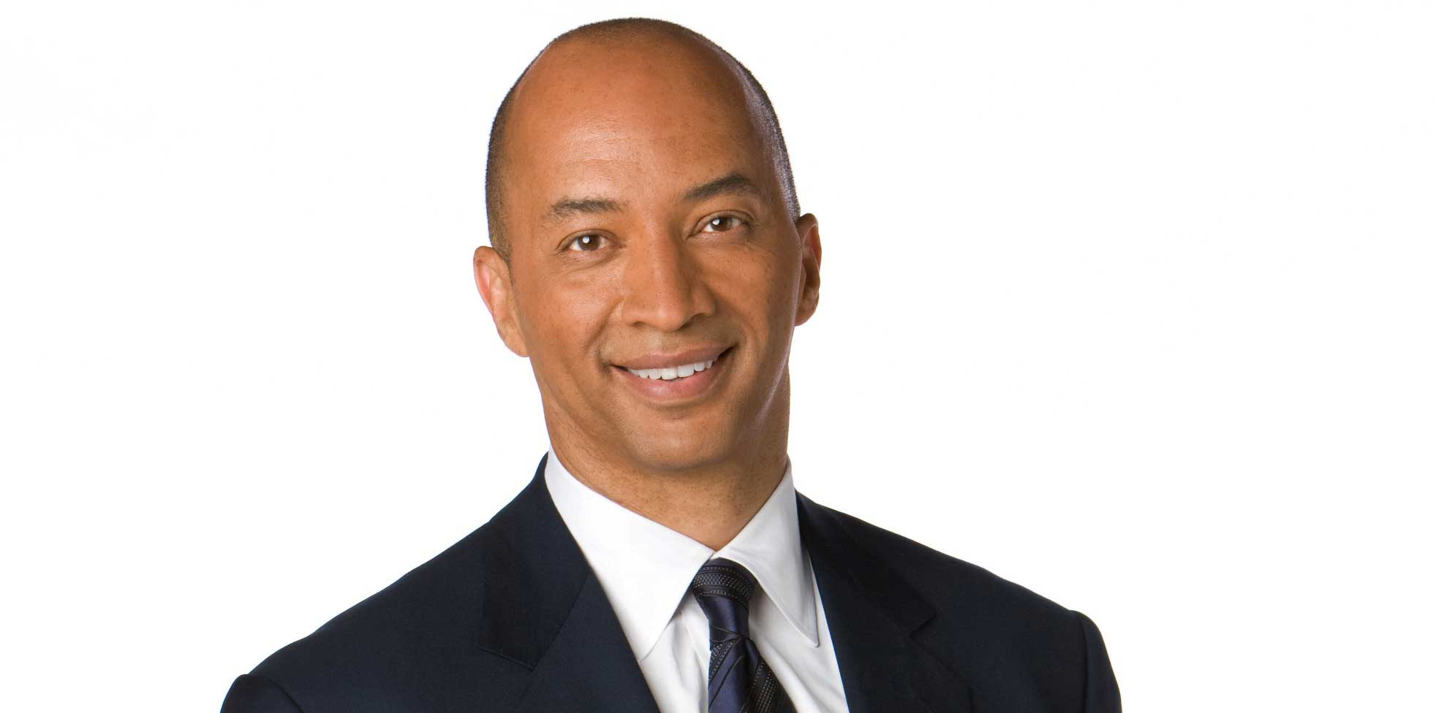

Slide 20
The Real-Time Web
Balancing speed with accuracy
Emergency notifications
Live event coverage
Notes:
20

Slide 21
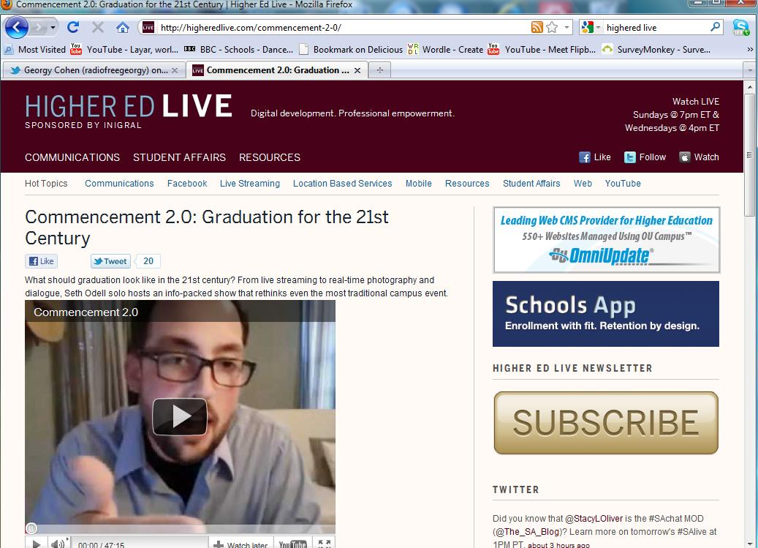
Notes:
21

Slide 22
the singularity
Notes:
22

Slide 23
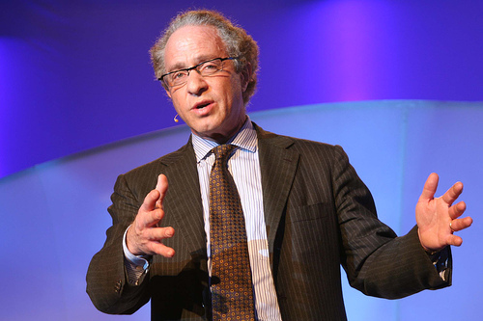
Notes:
23

Slide 24


Slide 25
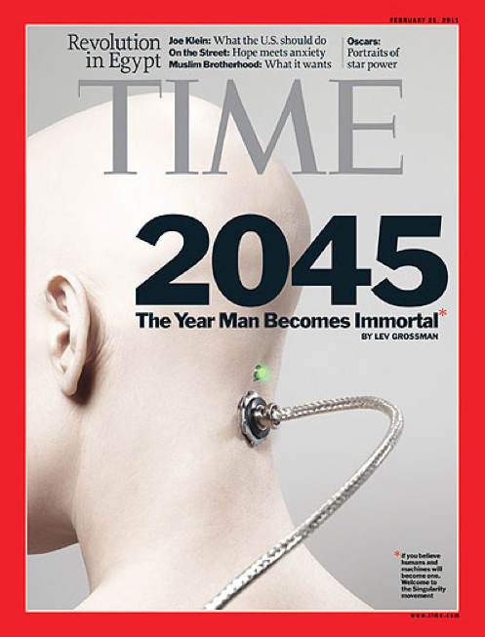

Slide 26
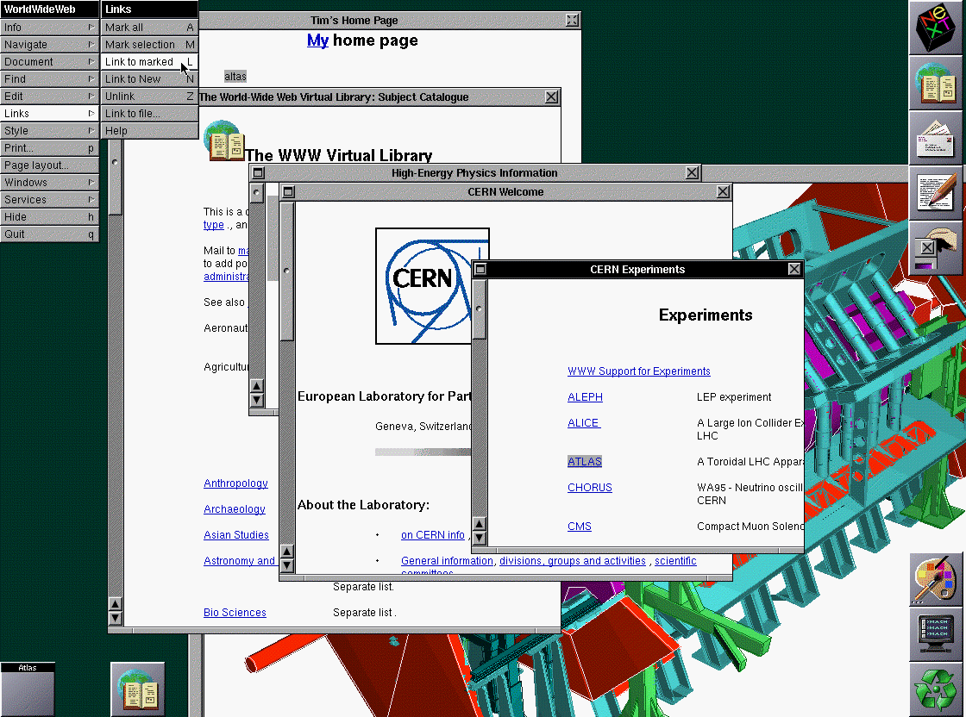

Slide 27


Slide 28


Slide 29
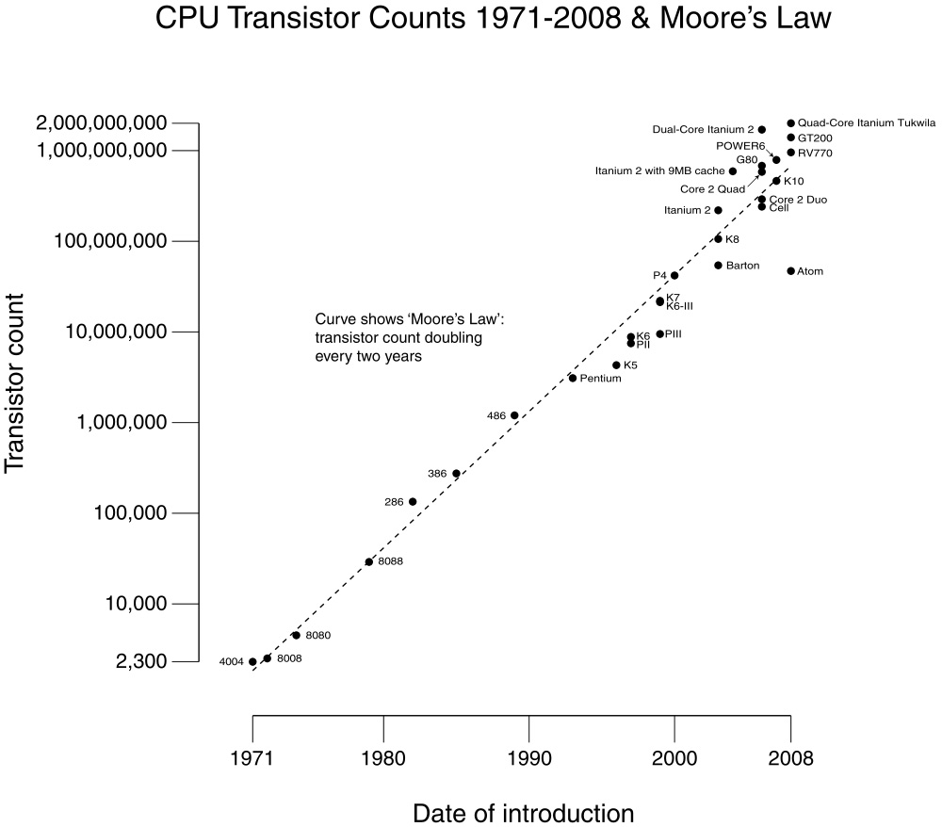

Slide 30
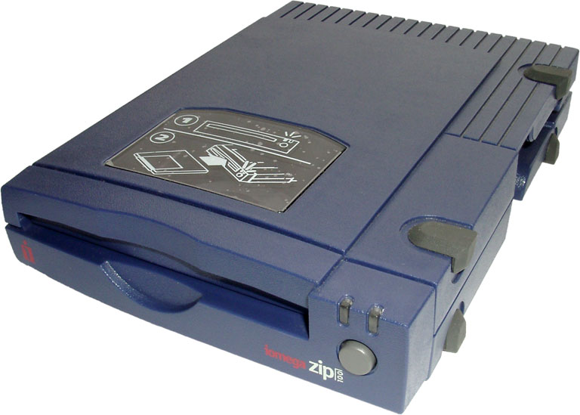

Slide 31
Notes:
31

Slide 32
computer
Notes:
32

Slide 33
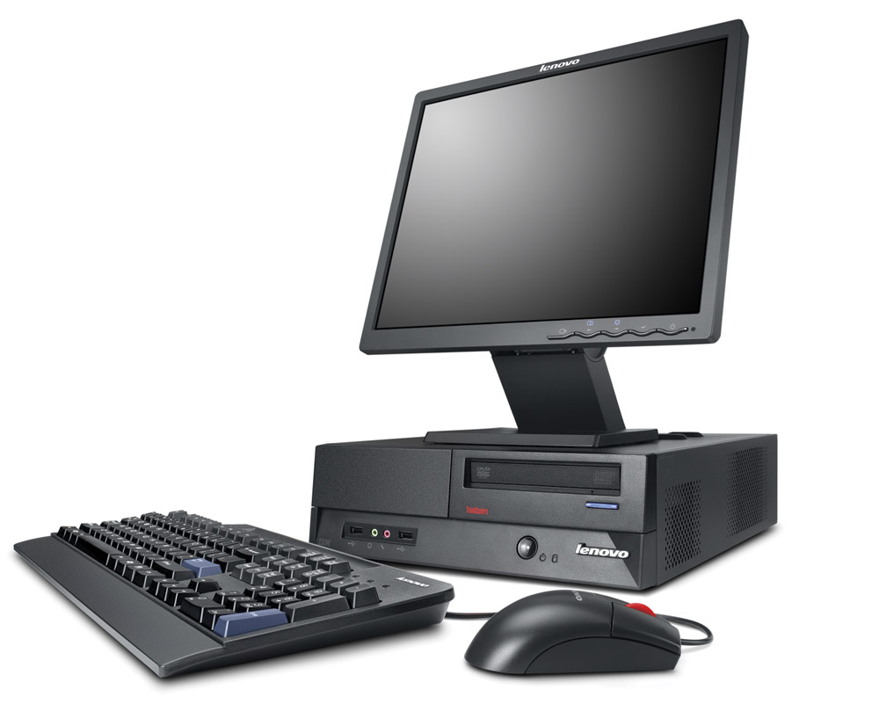

Slide 34
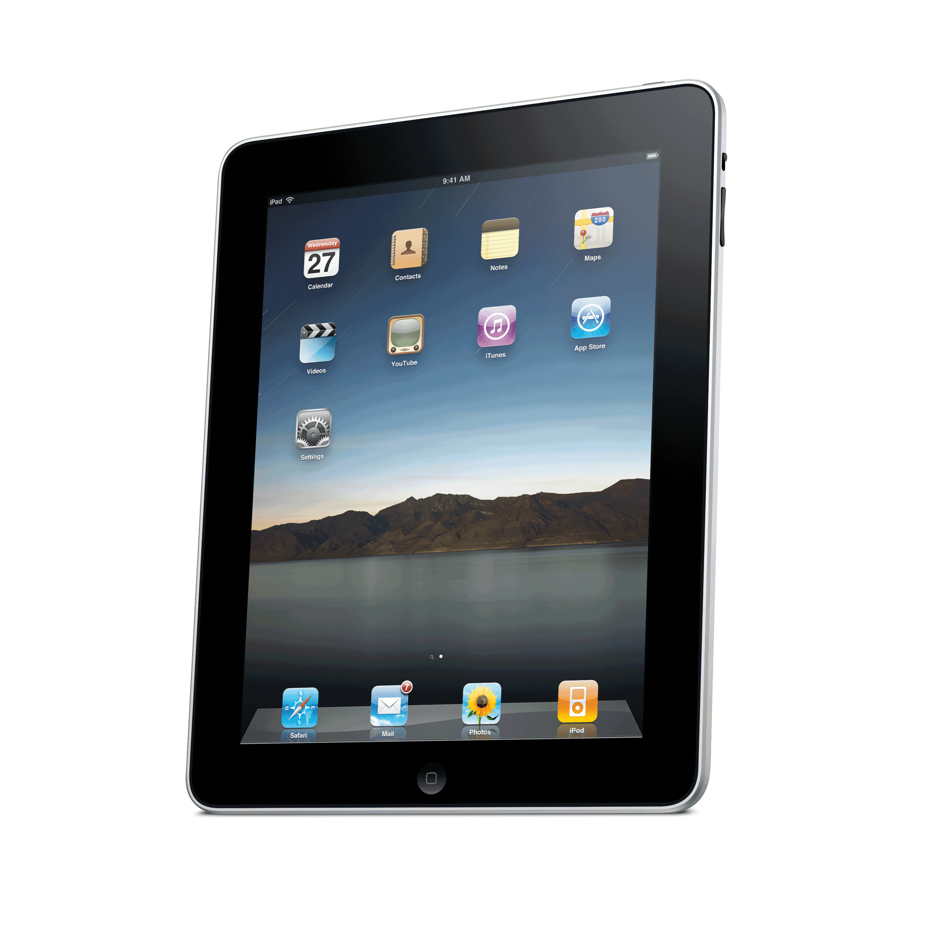
Notes:
34

Slide 35
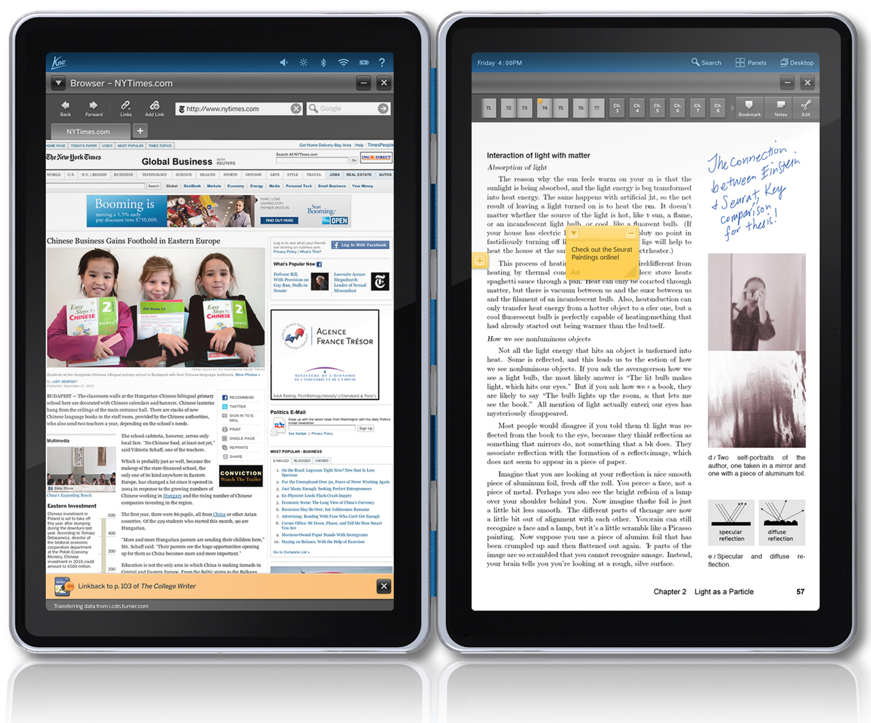

Slide 36


Slide 37
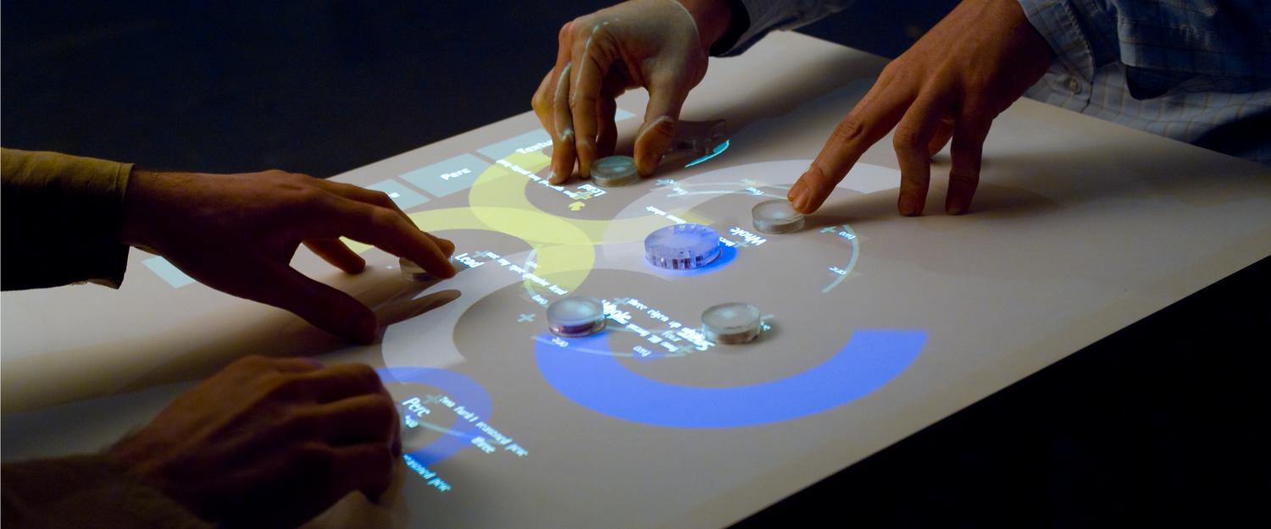
A Keyboard and a Mouse that’s so 1970’s
Notes:
37

Slide 38

Notes:
38

Slide 39
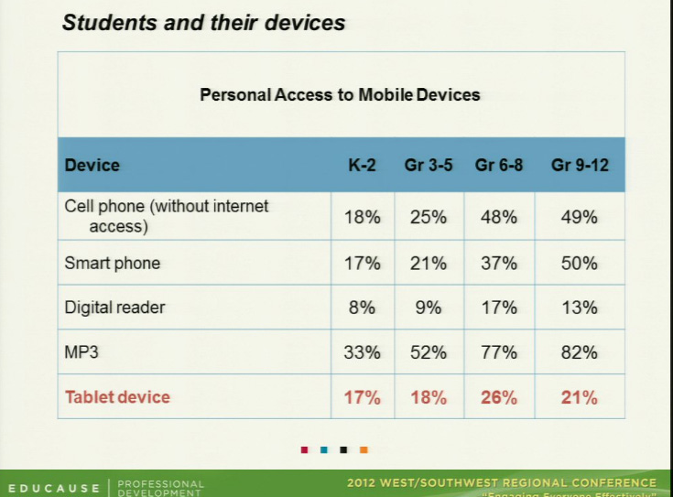
Notes:
Lance
Key things to remember about the mobile channel.

Slide 40
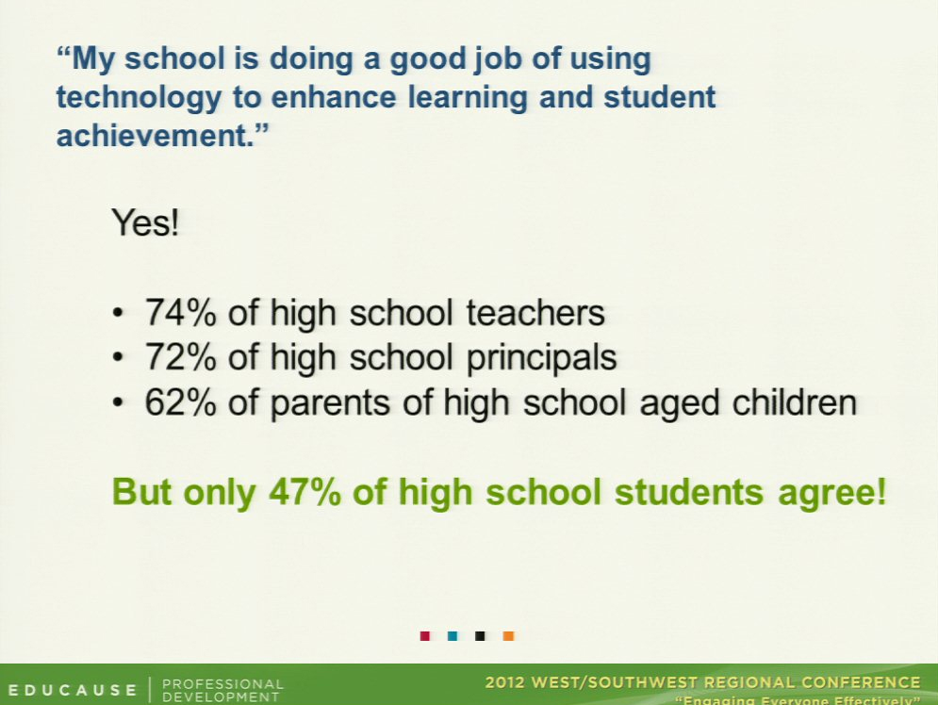
Notes:
Lance
Key things to remember about the mobile channel.

Slide 41
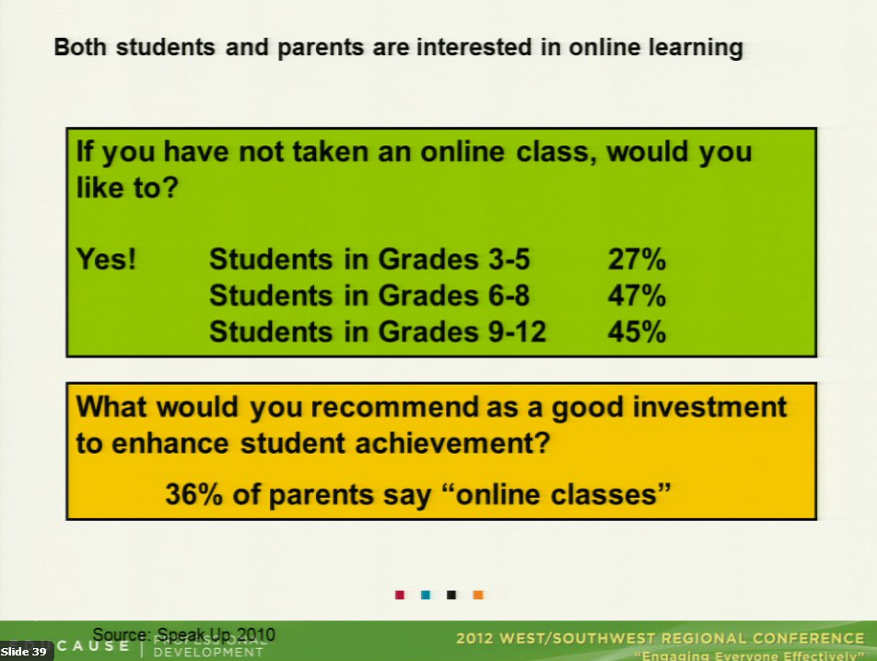
Notes:
Lance
Key things to remember about the mobile channel.

Slide 42
Marketing 2.0
Notes:
42

Slide 43

Million dollar TV ads are no longer the king influencer of purchase intent
People referring products and services via social media tools are the new king
Notes:
43

Slide 44
78% of consumers trust peer recommendations
14% trust advertisements
Notes:
44

Slide 45

“The arrival of the Net Generation means
that many of marketing’s fundamental tenets
must change”
Notes:
45

Slide 46

Notes:
46

Slide 47
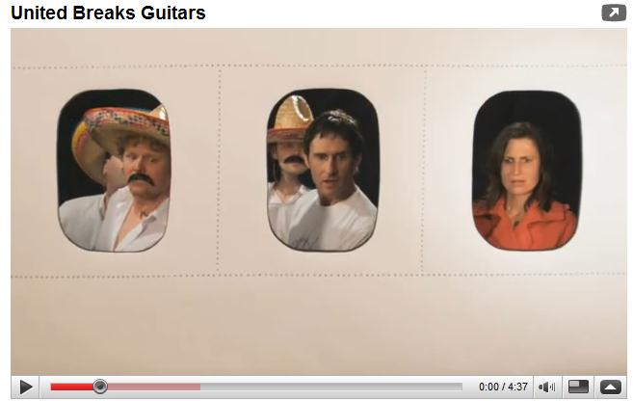
United Breaks Guitars

Slide 48


Slide 49
don’t just work on your brand
work on your reputation

Slide 50
Social Media Research
Notes:
50

Slide 51
Should colleges create a presence on social networks or communities to promote their programs?
2010 E-Expectations Survey
Yes 74%
No 23%
Don’t know 3%
Notes:
51

Slide 52
80% are looking for both official and unofficial content
2010 E-Expectations Survey
Notes:
52

Slide 53


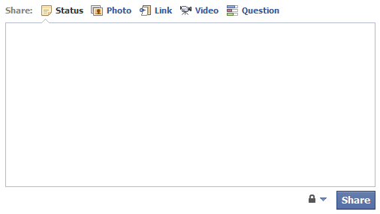
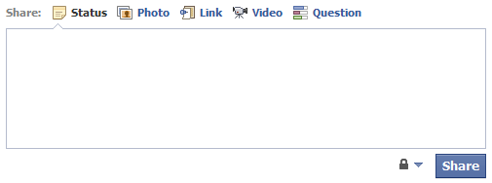
2011 Facebook Use
80% of STUDENTS use Facebook
48% of PARENTS use Facebook
Frequency:
30% many times/day
33% once/day
22% a few times to once/week
Frequency:
17% many times/day
37% once/day
30% a few times to once/week
27% viewed a school-specific site
15% of these students posted a comment or asked a question
12% viewed a school-specific site
26% of these parents posted a comment or asked a question

Slide 54



Most Appealing Facebook Content
Alumni Conversations (by or about)
3%
3%
Faculty Comments (programs, classes, research)
3%
8%
Athletic Info (games, scores)
16%
10%
General Info
(news, events, programs)
32%
20%
Current Student Comments
(campus life)
26%
53%

Slide 55
E-Expectations Survey
Twitter Usage
 | Percentage
2009 | .3%
2010 | 8%
2011 | 9%
2012* | 25%
Notes:
55

Slide 56
Social Media Strategies

Slide 57
Four Keys to Social Media Success
Notes:
57

Slide 58
Four Keys to Social Media Success
Authenticity
Notes:
58

Slide 59

Notes:
59

Slide 60
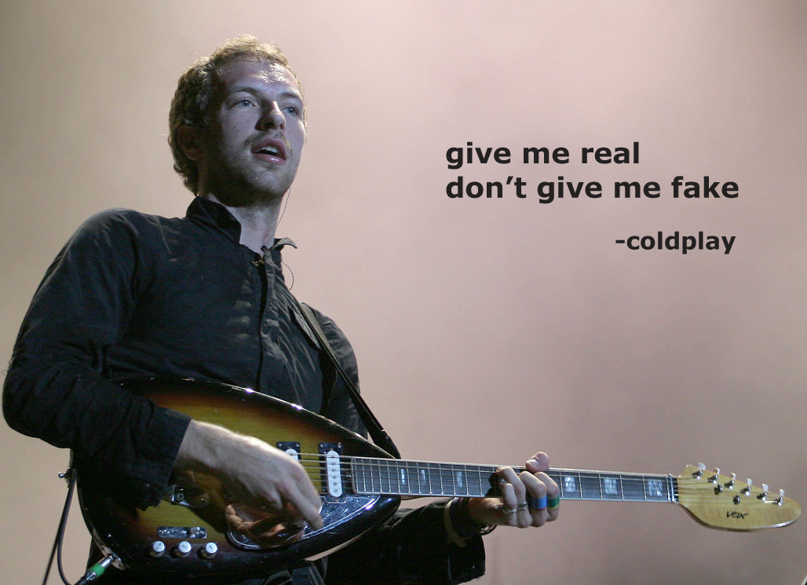

Slide 61
Four Keys to Social Media Success
Authenticity
Transparency
Notes:
61

Slide 62


Slide 63
Four Keys to Social Media Success
Authenticity
Transparency
Cede control
Notes:
63

Slide 64


Slide 65
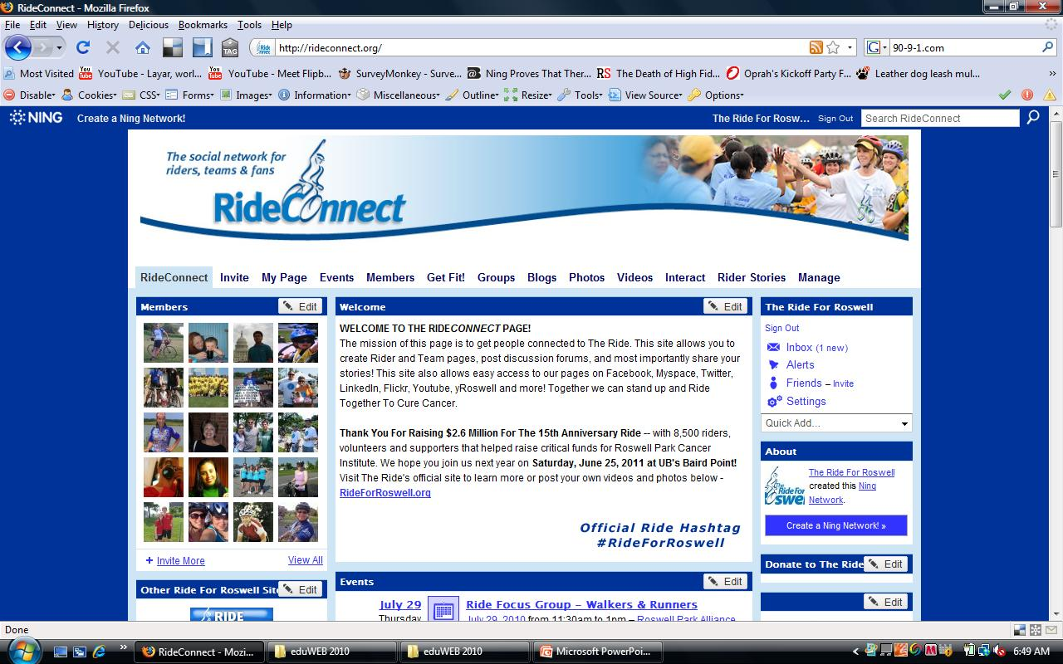
Notes:
65

Slide 66

No matter how compelling a technology or potential relationship might be, in the face of an immovable mass called company culture .. any digital strategy will fail
Notes:
66

Slide 67
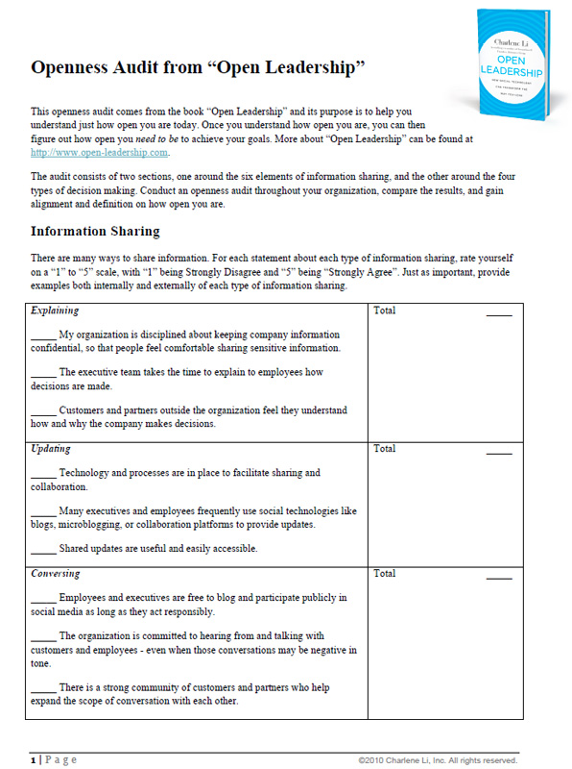

Slide 68
Four Keys to Social Media Success
Authenticity
Transparency
Cede control
Integrity
Notes:
68

Slide 69
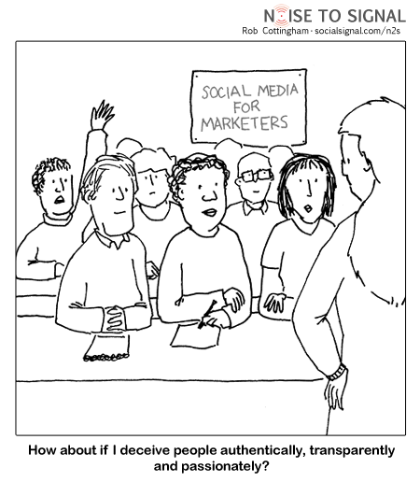
Notes:
69

Slide 70
Social Media Strategies

Slide 71
know what problem
you are trying to solve
Notes:
71

Slide 72
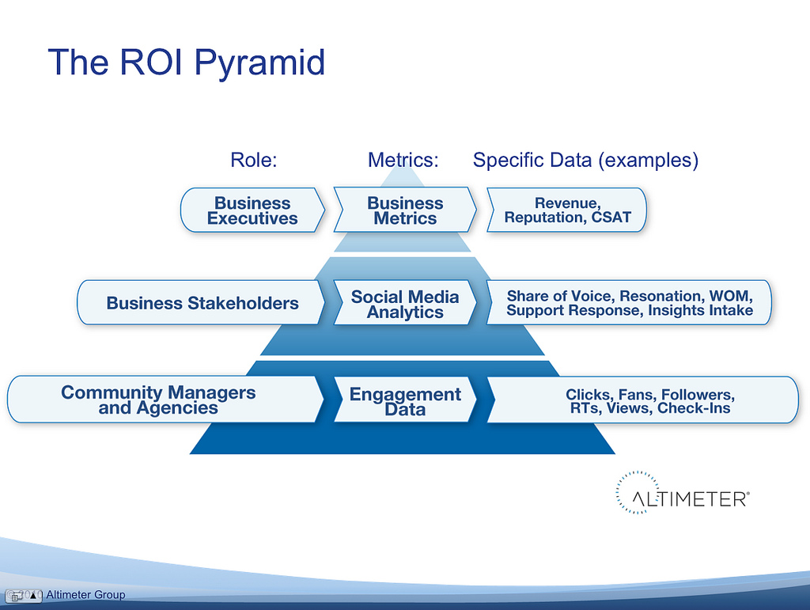
Notes:
72

Slide 73
focus on the relationships
not the technology
Notes:
73

Slide 74

P.O.S.T.
People
Objectives
Strategy
Technology
Notes:
74

Slide 75
Management and Governance

Slide 76
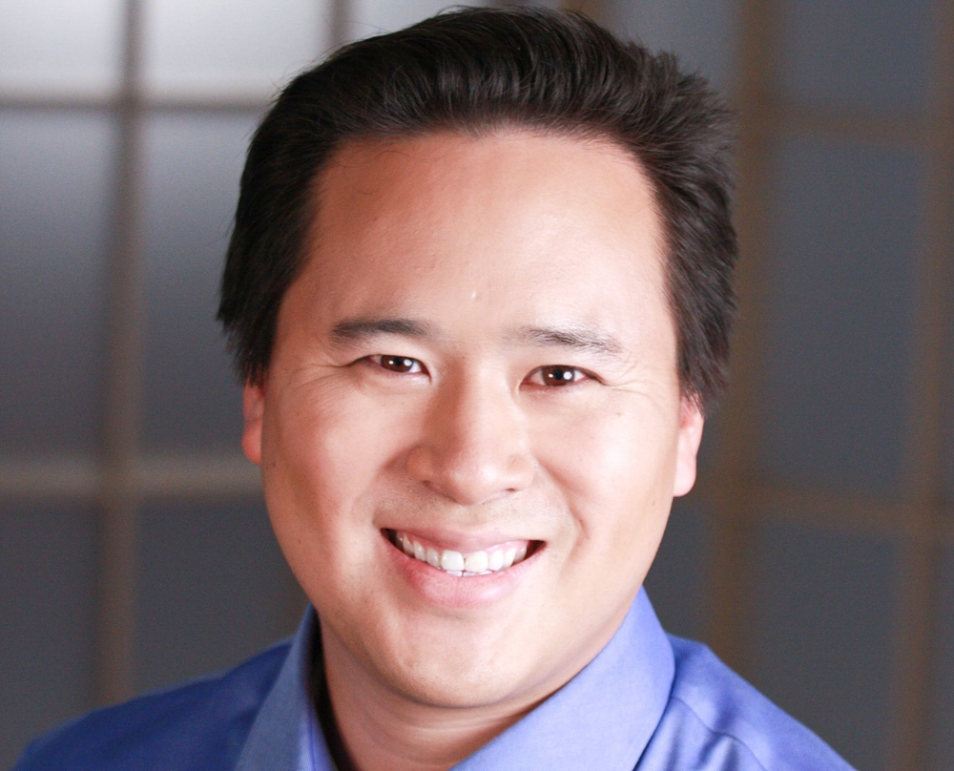

Slide 77
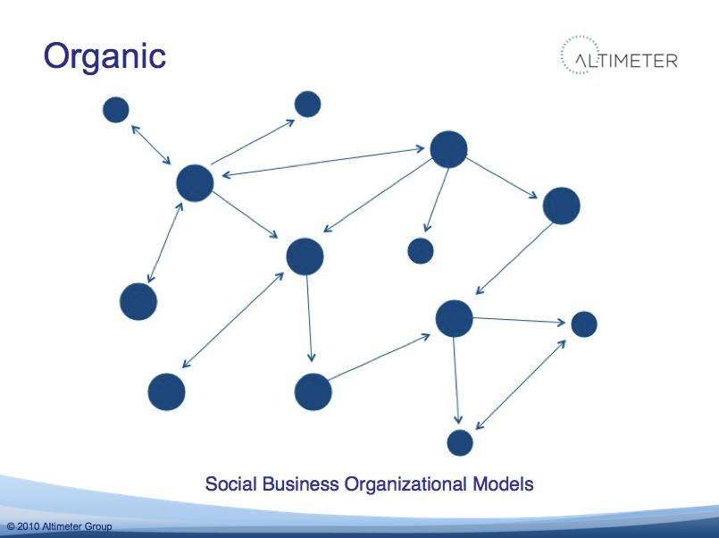

Slide 78
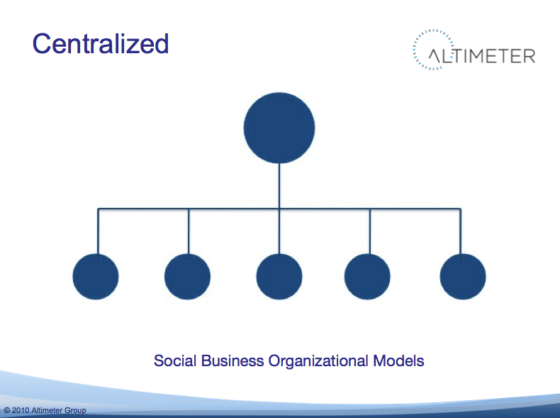

Slide 79
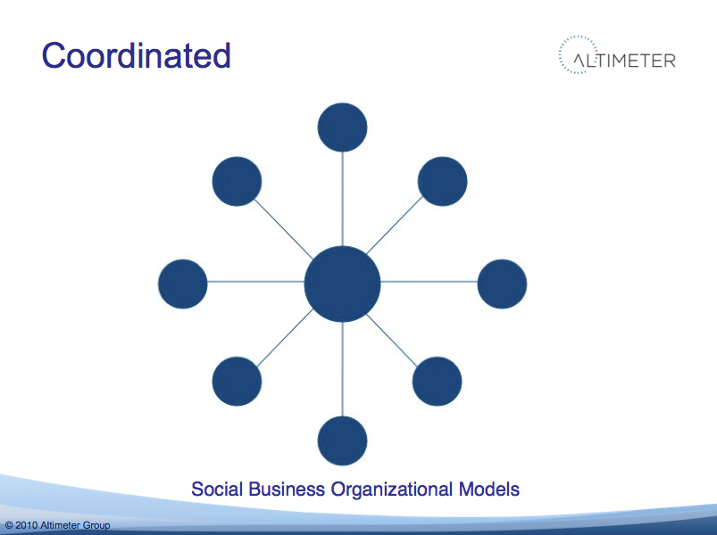

Slide 80
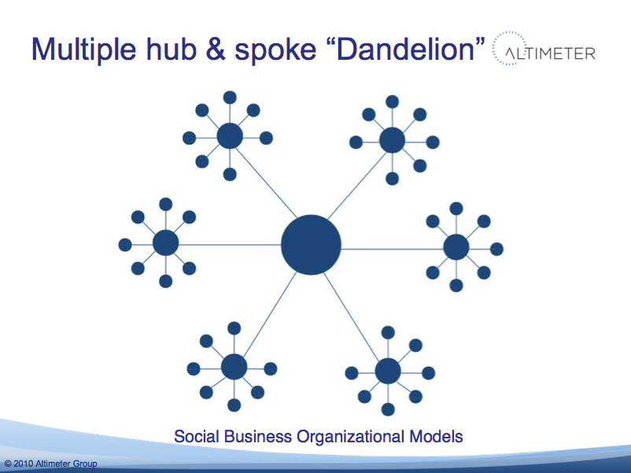

Slide 81
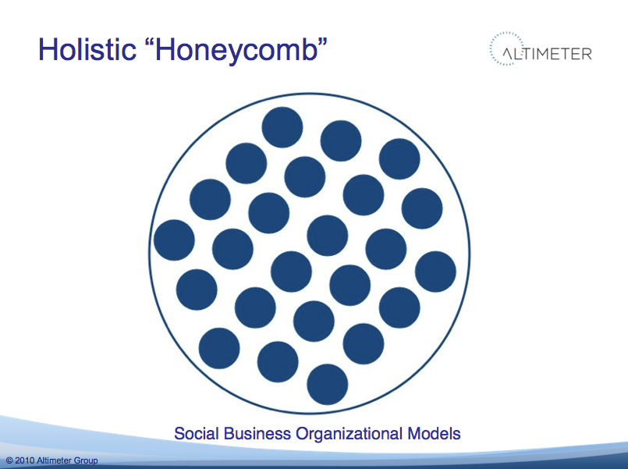

Slide 82

Notes:
82

Slide 83
policies and guidelines

Slide 84
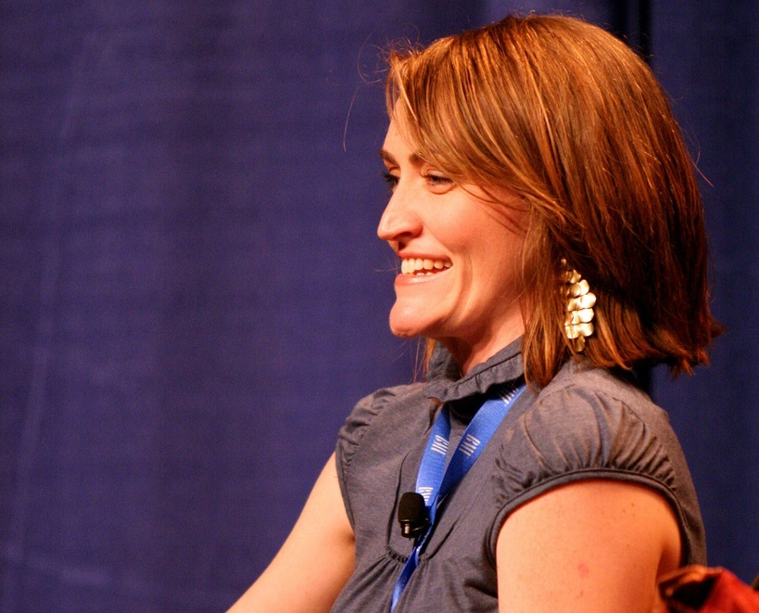

Slide 85
Dooced
"getting fired for something
you've written on your website"
Notes:
85

Slide 86
My advice to you is
BE YE NOT SO STUPID

Slide 87
Common sense is not so common
- Voltaire

Slide 88
if you delete a Facebook wall post
have you violated someone’s 1st amendment rights?

Slide 89
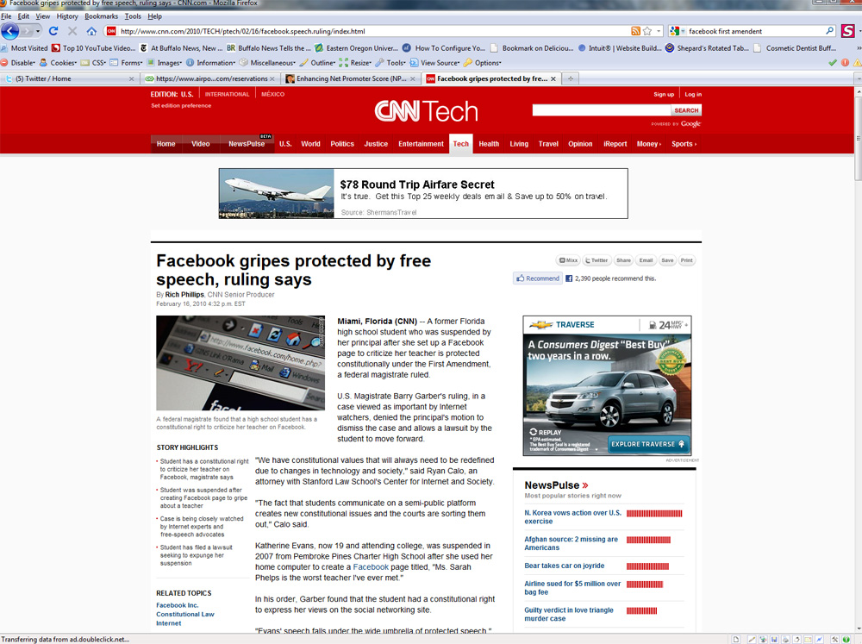

Slide 90
3 Types of Policies/Guidelines
Social Media Policies (legal)
Social Media Guidelines (best practices)
Community Policies

Slide 91
crisis planning

Slide 92
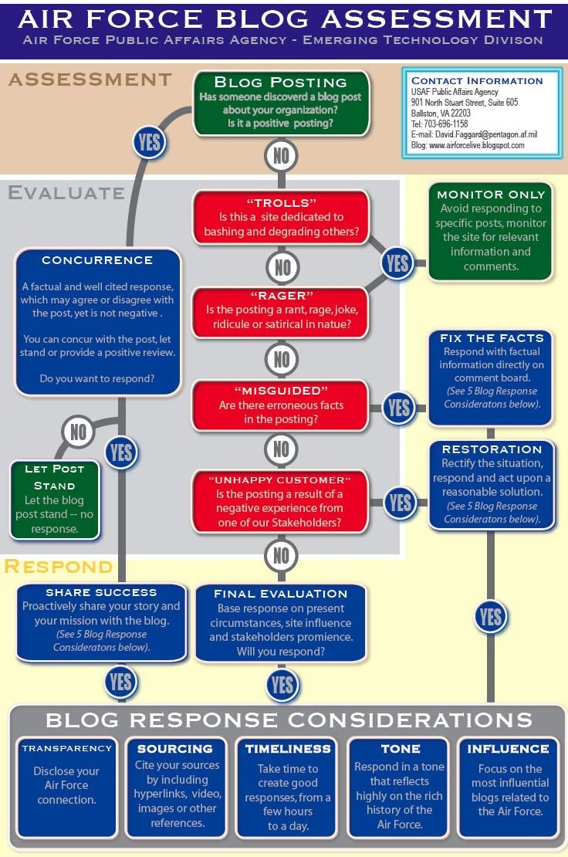

Slide 93
beware of the creepy treehouse
Notes:
93

Slide 94
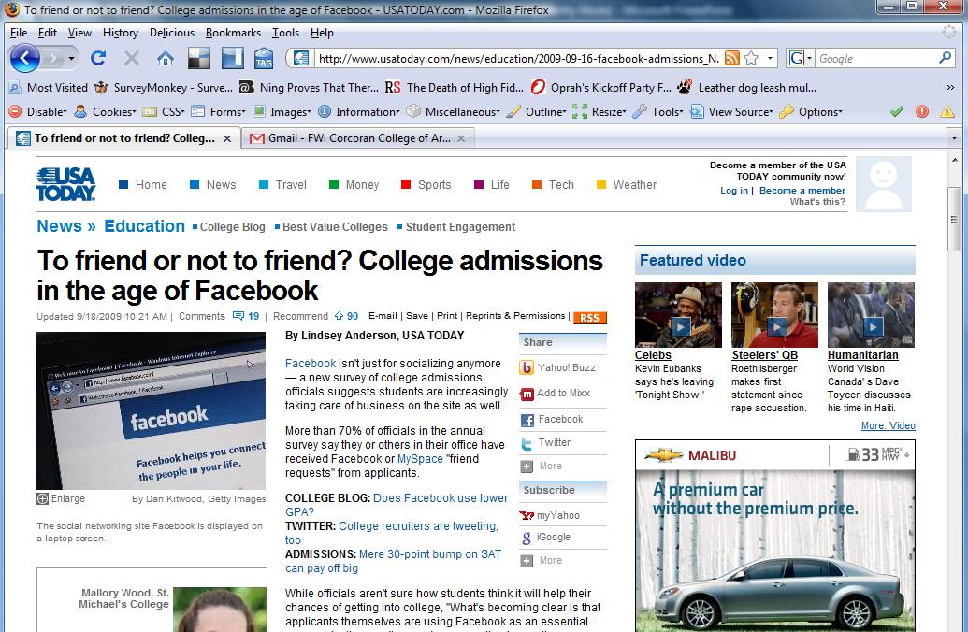
Notes:
94

Slide 95
67% say it is ok for an admissions counselor they’ve been working with to connect with them through social media
2010 E-Expectations Survey
Notes:
95

Slide 96
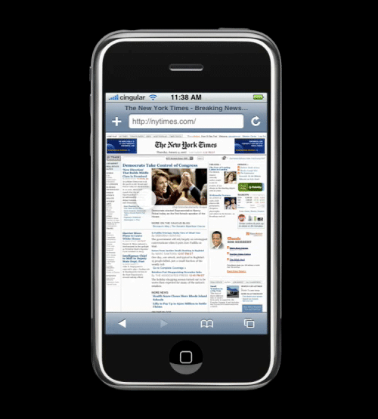
The Mobile Web
Notes:
96

Slide 97
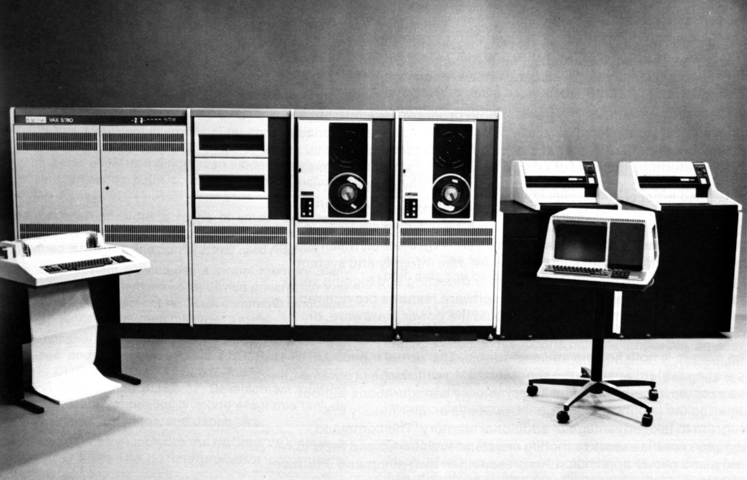

Slide 98
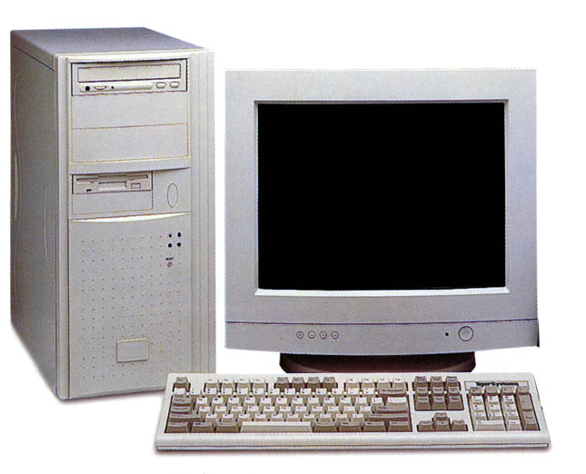
Notes:
98

Slide 99

Notes:
99

Slide 100
mobile is as different from the internet as tv is from radio

Slide 101
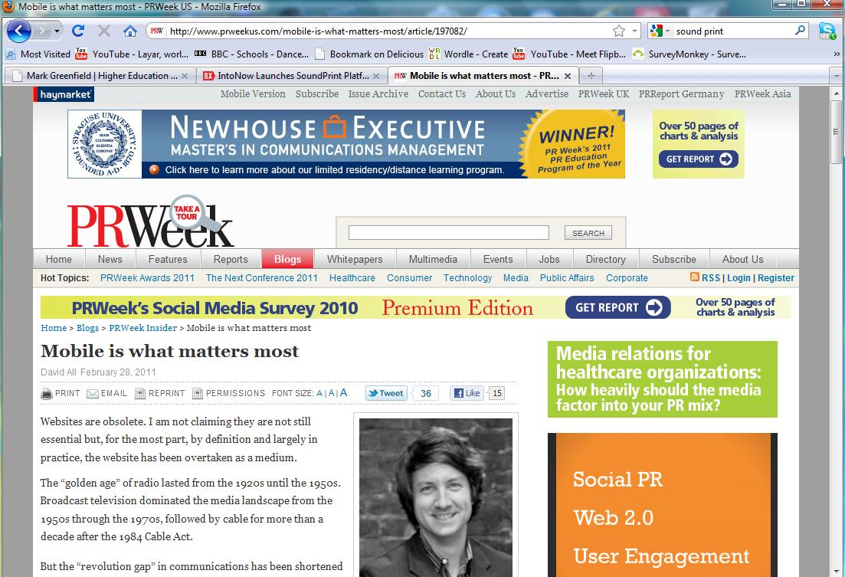
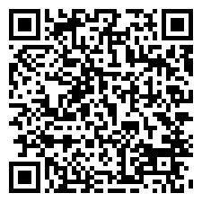

Slide 102
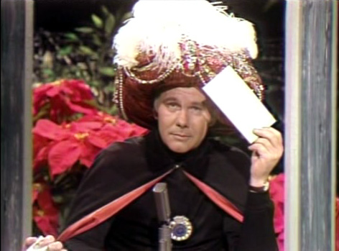
Carnac the Magnificent

Slide 103
1.37 Billion
The number of mobile phones sold last year
Notes:
103

Slide 104
5.2 Billion
The number of mobile phones subscription world-wide
Notes:
104

Slide 105
80%
The percentage of people who will access the Internet from a mobile device by 2015.
(It’s already 75% in Japan)
Notes:
105

Slide 106
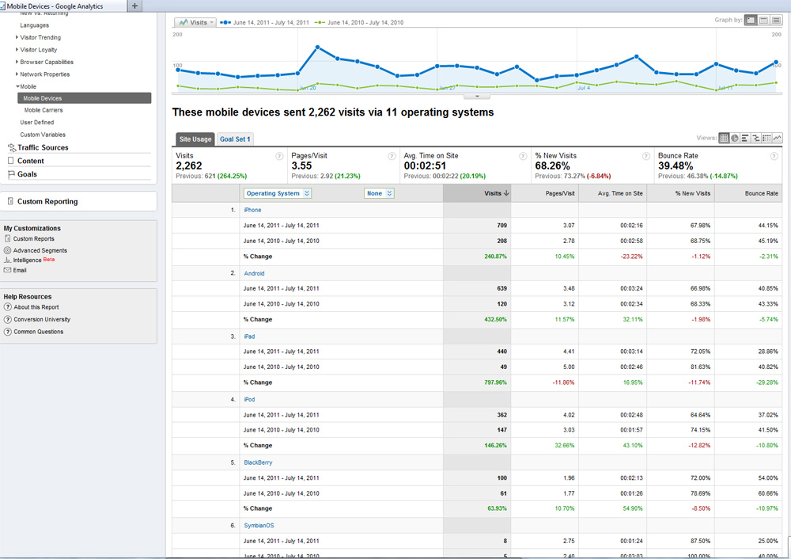

Slide 107
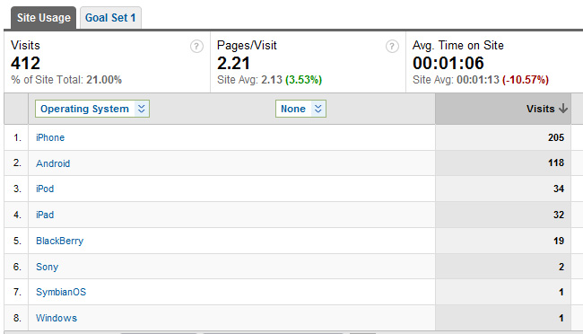

Slide 108
150
The number of times the average person checks their mobile phone per day
Notes:
108

Slide 109
42%
Percentage of teens in the U.S. can send a text message blindfolded.
(They can type faster on a phone than a QUERTY keyboard)
Notes:
109

Slide 110
American Teens and Young Adults:
“What’s your favorite way to communicate?”
Text Messaging – 68%
Voice (mobile call) – 9.2%
Facebook – 8.8%
Instant Messaging – 2.8%
E-mail – 0.2%
Notes:
110

Slide 111

2010 E-Expectations Report
23% of high school students
reported searching college sites from their smart phones.
Notes:
111

Slide 112
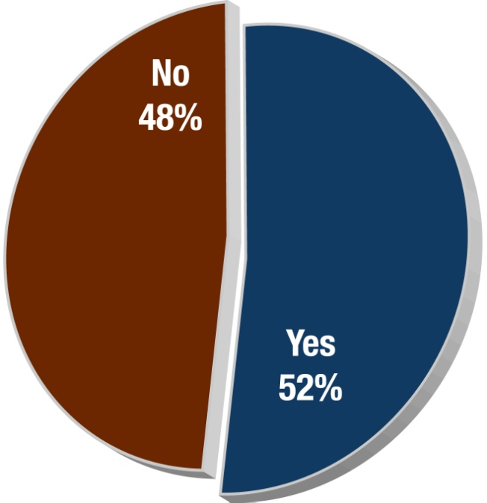
2012 - More than half have accessed your site through a mobile device
Just 4% are doing so through a tablet
Have you viewed a school’s Web site on a mobile device?
96% used a mobile browser rather than a specific application
Notes:
Devices:
18% Android
16% iPhone
61% other
3% iPad
1% other tablet
Of those who didn’t the most common reasons why not included:
Not at that stage in their enrollment process yet.
Insufficient data plans
Prefer to view on their PC/larger screen

Slide 113
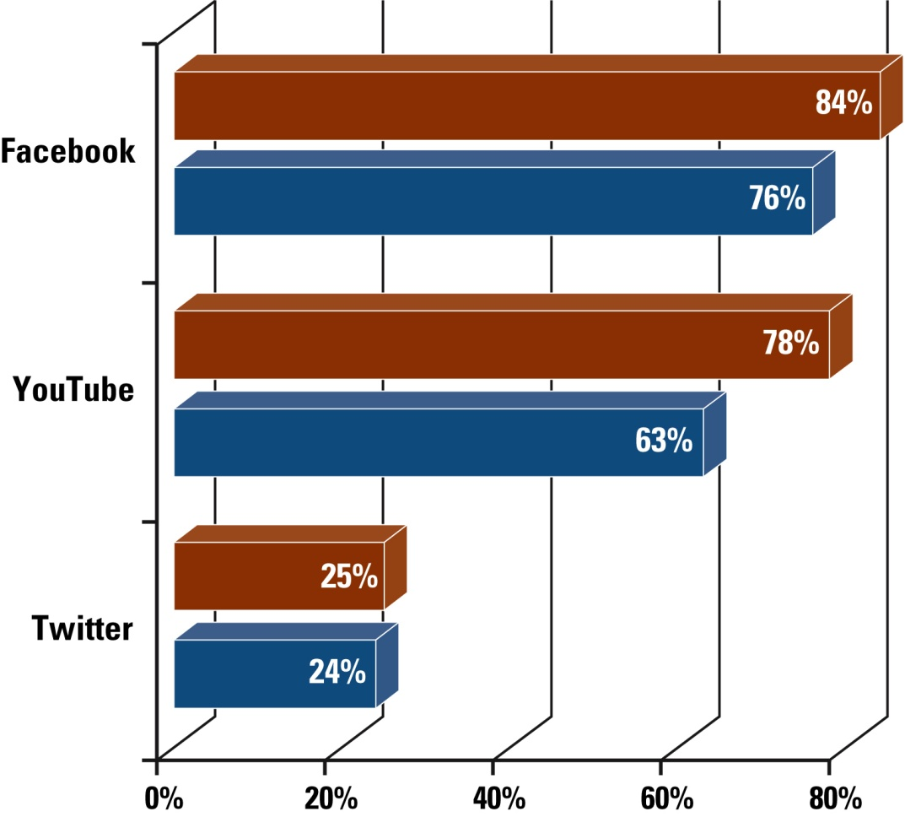
Many use social media AND access via mobile device
Red bar = use of that resource
Blue bar = regular mobile access
Notes:
5% of all survey responders said they didn’t use any social media assets.
Twitter use is much higher (9% vs. 25%) than in previous E-expectations studies

Slide 114

What would students most like to DO on a mobile site for a college or university?
77%
Calculate college costs
75%
Calculate scholarships
65%
Schedule a visit
64%
Watch videos
62%
Access social media assets
53%
IM with admissions reps
44%
Complete an online application

Slide 115
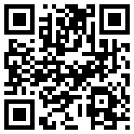
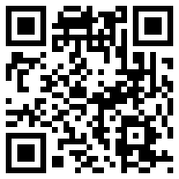
QR Code Exposure
Students
Parents
Have you seen QR codes before?
15%
14%
yes
If yes, have you used them for a college?
6%
4%
yes

Slide 116
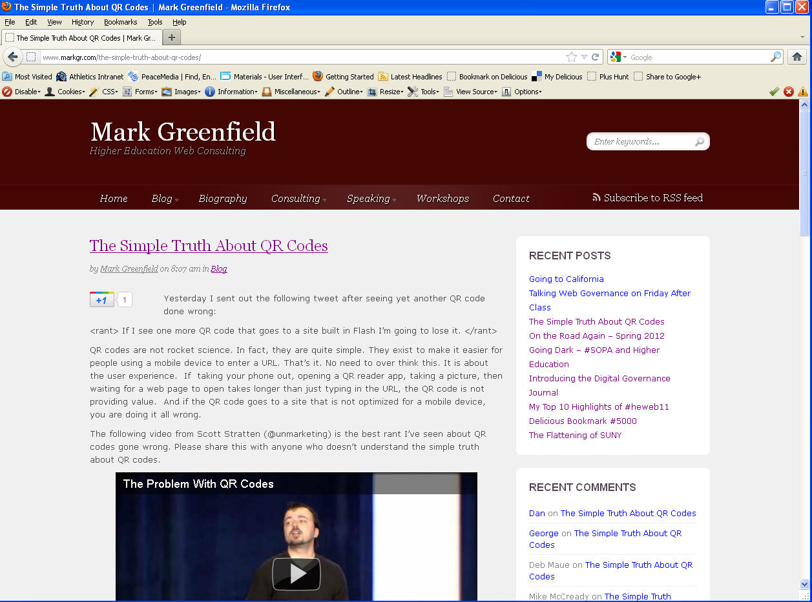

Slide 117
An Incremental Approach
Make your site presentable
Responsive design
Mobile Web Site
Mobile Apps
Notes:
117

Slide 118
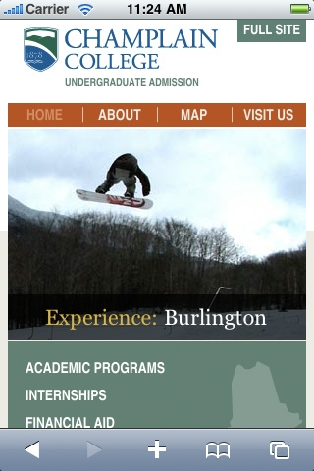




Slide 119




Slide 120


Inspiration
Notes:
120

Slide 121
Convergence
Technology Convergence
Content Convergence

Slide 122


Slide 123
Notes:
123

Slide 124


Slide 125
Your mobile phone is not a phone!!!
Voice Calls
Computer
GPS
Accelerometer
Camera/microphone/speakers
Notes:
125

Slide 126

Content Convergence
Notes:
Lance
Channels create new opportunities and challenges, but let’s not forget it’s the content that matters. Form follows function, but the heart and soul of marketing is messaging.

Slide 127

Content is like water…
it takes on the shape of the system that presents it
Notes:
Lance
If you think about it, content is like water. It takes on the shape (and characteristics) of the presentation system: print (newspaper, magazine, book), human, web, text message, twitter, etc.

Slide 128





Web
Social
Mobile
Notes:
Lance
Assuming great content, one of the biggest challenges you face today is a technology challenge. Your role is that of content conductor.

Slide 129






Separate Content from Design
Page
Page
Page
Template
Template
CMS
content
design
Notes:
Lance
One of the core components of a CMS that ensures your brand and image stays on track is in the way the technology separates content from design. Content is allowed to flow and fit perfectly into the design, and the design can change over time without ever touching the content.

Slide 130




Multi-Channel Output
Web Page
Template
Content
Template
XSLT 2.0
Social
Template
Mobile
Notes:
Lance
A CMS also enables content to flow outward to the other channels that matter. Content that’s updated on the website is automatically updated on facebook and other social networks, just as it’s updated on your mobile web presence.

Slide 131
Integration
How do the pieces fit together
Approach from the user’s perspective
Create and promulgate a standard hashtag(s)
Notes:
131

Slide 132


Slide 133


Slide 134

Notes:
134

Slide 135
are we doing it all wrong?
Notes:
135

Slide 136
I strongly argue that companies that blindly link away to Facebook and Twitter from their corporate homepage are doing themselves a disfavor.
- Jeremiah Owyang
Notes:
136

Slide 137

Notes:
137

Slide 138
Concluding Thoughts
Notes:
138

Slide 139
your .edu site is the foundation
for all your online activities

Slide 140
it’s not about your web site
it’s about your web presence
Notes:
140

Slide 141
think contribute, not control

Slide 142

Managing the Unmanagable
Digital Governance in Higher Education
mark a. greenfield

Slide 143

Notes:
143

Slide 144

Notes:
144

Slide 145
Thank You
mark a greenfield
markgr.com
twitter.com/markgr
delicious.com/markgr
Notes:
145

